Slide 1




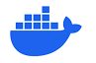
Deploying R(eplicable) Data Projects
With the help of AWS, Docker, and Terraform
Tyler Sanders
Clawed Z. Eagle 2016-2019
Senior Solutions Architect, Red Oak Strategic
Github Repo: https://github.com/ty-sanders/Deploying-R-Based-Data-Solutions-on-AWS
LinkedIn: https://www.linkedin.com/in/tyler-sanders-8275b5150/
Company Profile: https://www.redoakstrategic.com/about

Slide 2
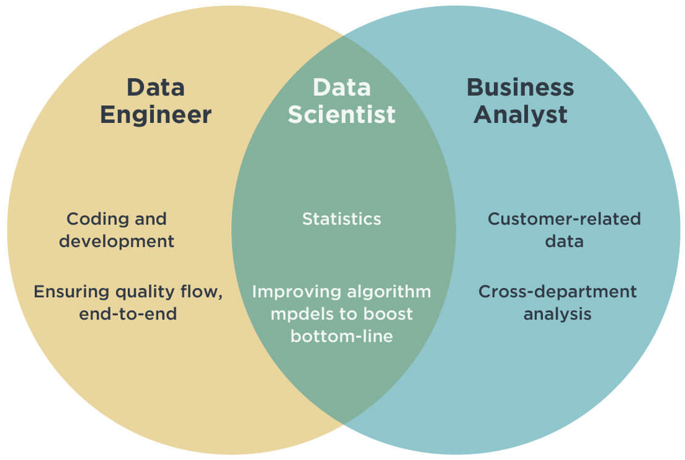
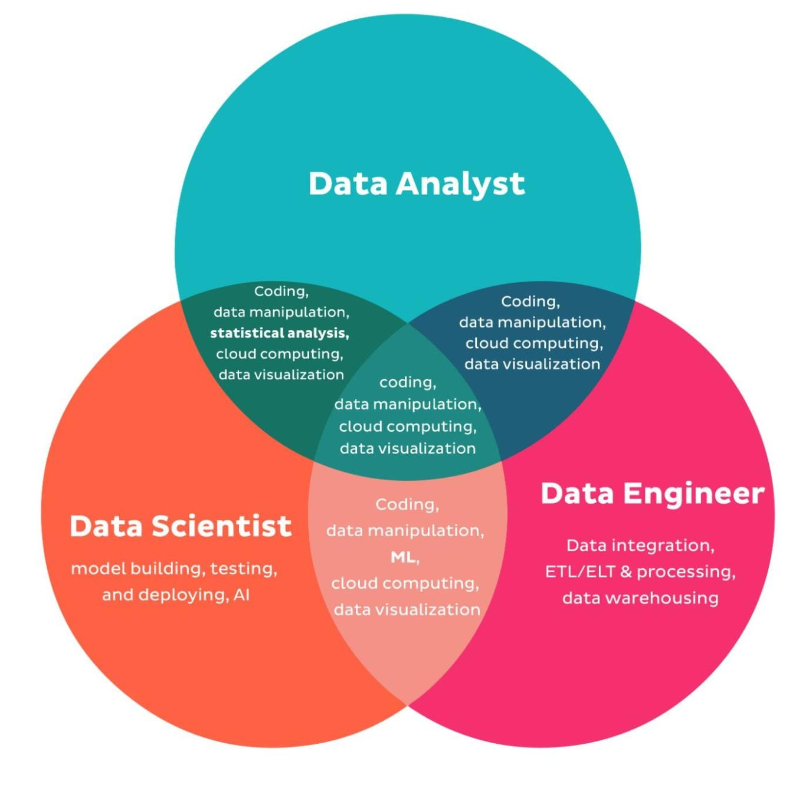
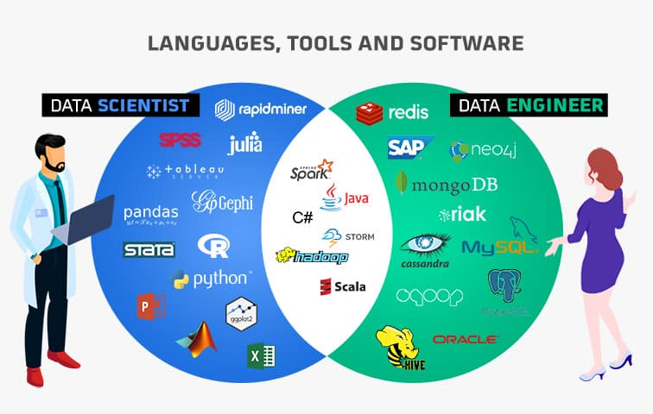
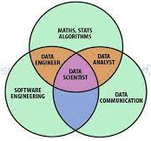
R & Data Science in Consulting
Github Repo: https://github.com/ty-sanders/Deploying-R-Based-Data-Solutions-on-AWS
LinkedIn: https://www.linkedin.com/in/tyler-sanders-8275b5150/
Company Profile: https://www.redoakstrategic.com/about

Slide 3
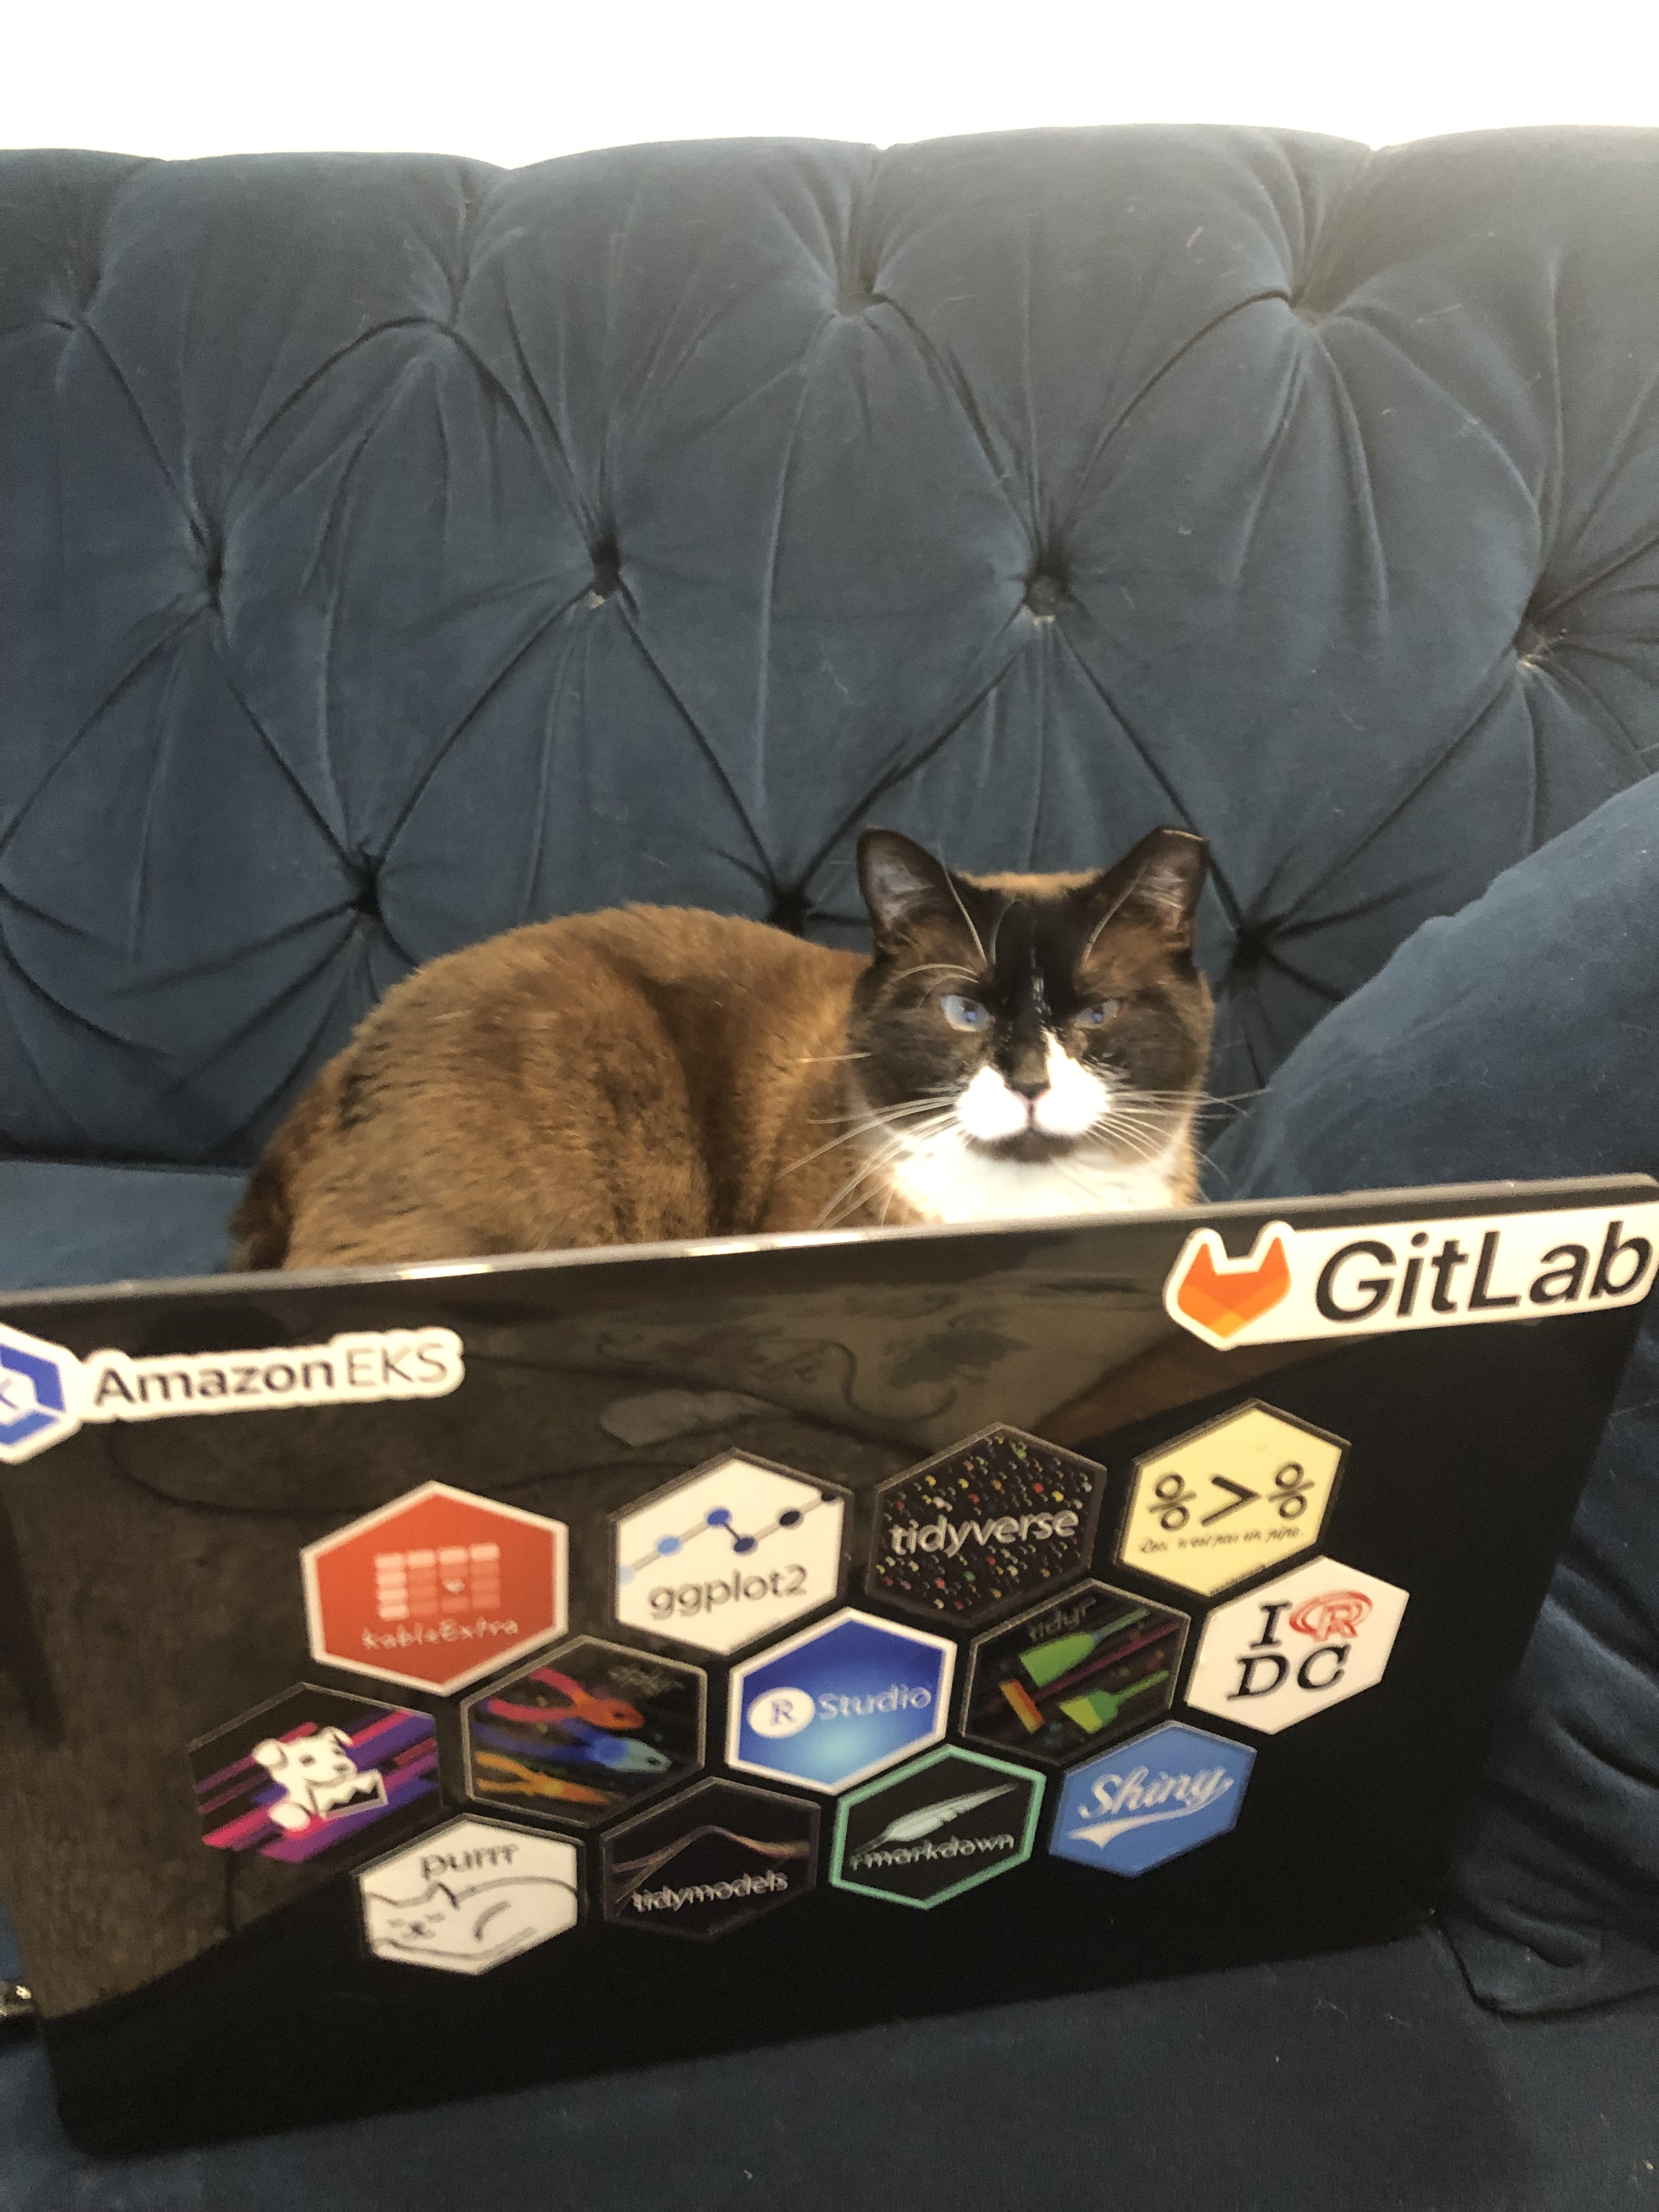

My Data Tool Belt
Forever my first (and favorite) programming language
Tidyverse fan and an improving functional programmer
Reporting, Mapping, Modeling, Exploratory Analysis
Used internally – now an “expert”
80% frustrating, 20% superpower
Fast, managed services, low-risk, pay as you go
Newbie
Applying R best practices to infrastructure
Cloud-Agnostic
Command-Line Interface (bash)
And the of course VERSION CONTROL
Stand on the shoulders of Giants
Scale-out AND Scale-up
No more package version mismatches PLEASE
Secure (when used correctly)
Github Repo: https://github.com/ty-sanders/Deploying-R-Based-Data-Solutions-on-AWS
LinkedIn: https://www.linkedin.com/in/tyler-sanders-8275b5150/
Company Profile: https://www.redoakstrategic.com/about

Slide 4
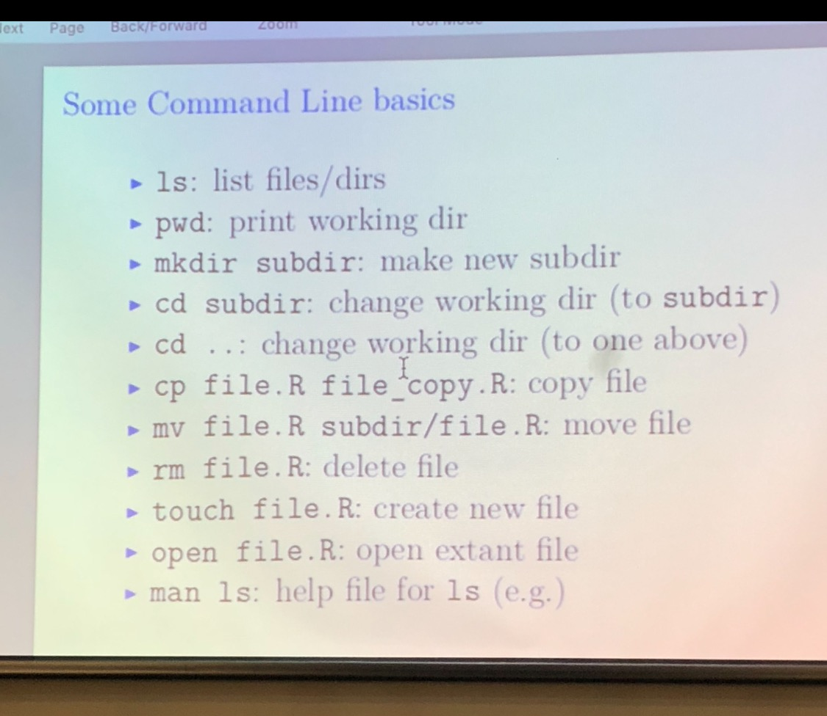

Let’s (get ready to) Deploy!
Pre-Reqs:
AWS Account created and IAM User with `AdministratorAccess` and Access Keys
AWS credentials file updated with Access Keys (~/.aws/credentials but don’t tell anyone)
Your Favorite R Shiny Application and any local data inputs placed in a specific folder (that ideally is already its own R Project directory)
Terraform installed
Docker and DockerDesktop installed
Access to a CLI (I’m using Mac Terminal running Bash) and a GUI (VSCode )
Github Repo: https://github.com/ty-sanders/Deploying-R-Based-Data-Solutions-on-AWS
LinkedIn: https://www.linkedin.com/in/tyler-sanders-8275b5150/
Company Profile: https://www.redoakstrategic.com/about

Slide 5
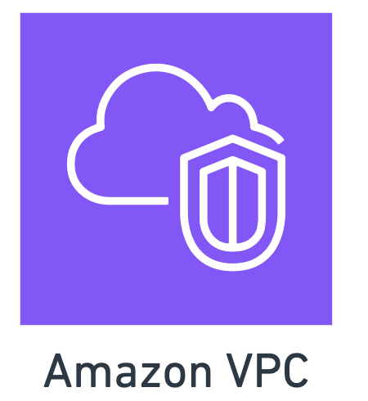
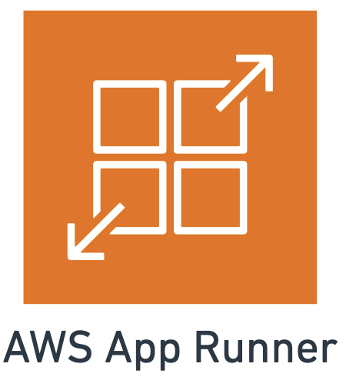


Architecture Diagram
Github Repo: https://github.com/ty-sanders/Deploying-R-Based-Data-Solutions-on-AWS
LinkedIn: https://www.linkedin.com/in/tyler-sanders-8275b5150/
Company Profile: https://www.redoakstrategic.com/about

Slide 6
Helpful Commands
Terraform Commands:
Terraform init
Terraform plan
Terraform apply
Docker to ECR Push Commands: (contextualized)
aws --profile=ros-sandbox ecr get-login-password --region us-east-1 | docker login --username AWS --password-stdin 088130860316.dkr.ecr.us-east-1.amazonaws.com
docker build -t r-shiny-app-runner .
docker tag r-shiny-app-runner:latest 088130860316.dkr.ecr.us-east-1.amazonaws.com/r-shiny-app-runner:latest
docker push 088130860316.dkr.ecr.us-east-1.amazonaws.com/r-shiny-app-runner:latest
Github Repo: https://github.com/ty-sanders/Deploying-R-Based-Data-Solutions-on-AWS
LinkedIn: https://www.linkedin.com/in/tyler-sanders-8275b5150/
Company Profile: https://www.redoakstrategic.com/about

